Slide 1
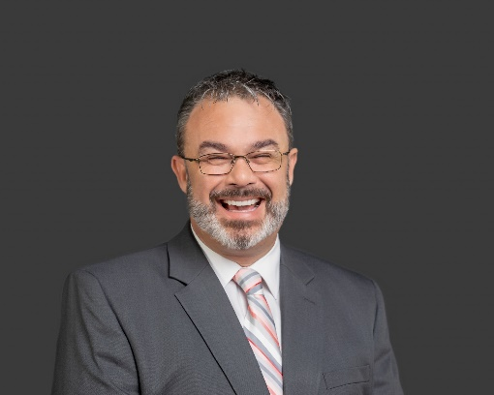



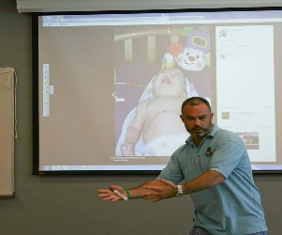
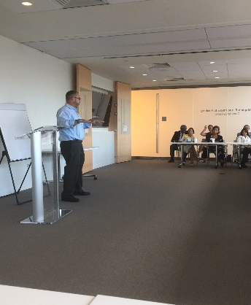
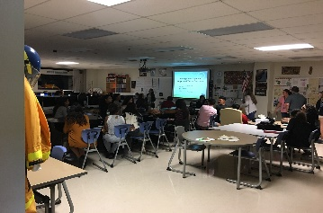
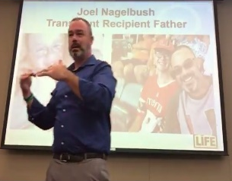
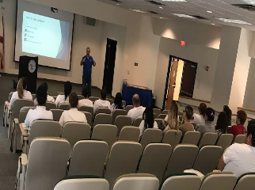
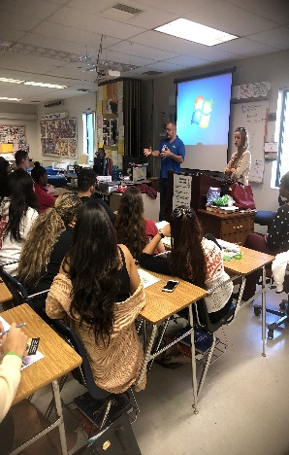
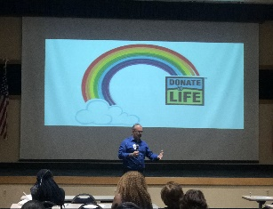
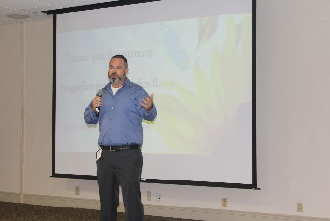

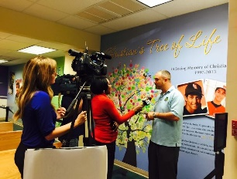

MR. NAGELBUSH
CLC, MS/HRM
Certified Life Coach and Motivational Speaker
Speaking Topics
Taking Advantage of Change
Communication strategy and decision-making models create opportunity to pivot and take advantage of change
Inclusivity is Key to Managing Change
Inclusive cultures have a distinct advantage because decision-making processes and speedy problem-solving models
Needs Analysis and Finding Purpose
Clearly Defining needs and purpose is the key to Sustaining a Competit3ve Advantage in Your Life and your organization.
Mr. Joel Nagelbush currently serves as the CEO of The Change Management Company LLC, a company that Teaches people and organizations how to find Purpose in Change. In addition to his role as CEO, Joel serves as a member of the National Speakers Bureau and a Wish Granter for the Make a Wish Foundation®. Also, Joel is an Ambassador for the Life Alliance and Organ Recovery Agency (LAORA), where he raises awareness of the benefits of organ donation through public speaking, media events, and community outreach. Joel holds a Master of Science degree with a Certificate in Strategic Human Resource Management from Capella University and is a Doctoral Candidate in Strategy and Innovation at Capella University School of Business and Technology
JUNE 2, 2018
Contact Info:
954-913-8703
FosterAnImpact.org
Joel@FosterAnImpact.org

